Slide 1

Attrition at D.D.S. Analytics
A study of factors related to employee turn-over
Presented by:
Justin Howard

Slide 2

Our People, by the numbers
Over-all Attrition Rate
16.09%
870 employees
730 have stayed
140 have left
Gender Breakdown
40% Female
60% Male
Median Age
35
Median years with the company
5 years

Slide 3
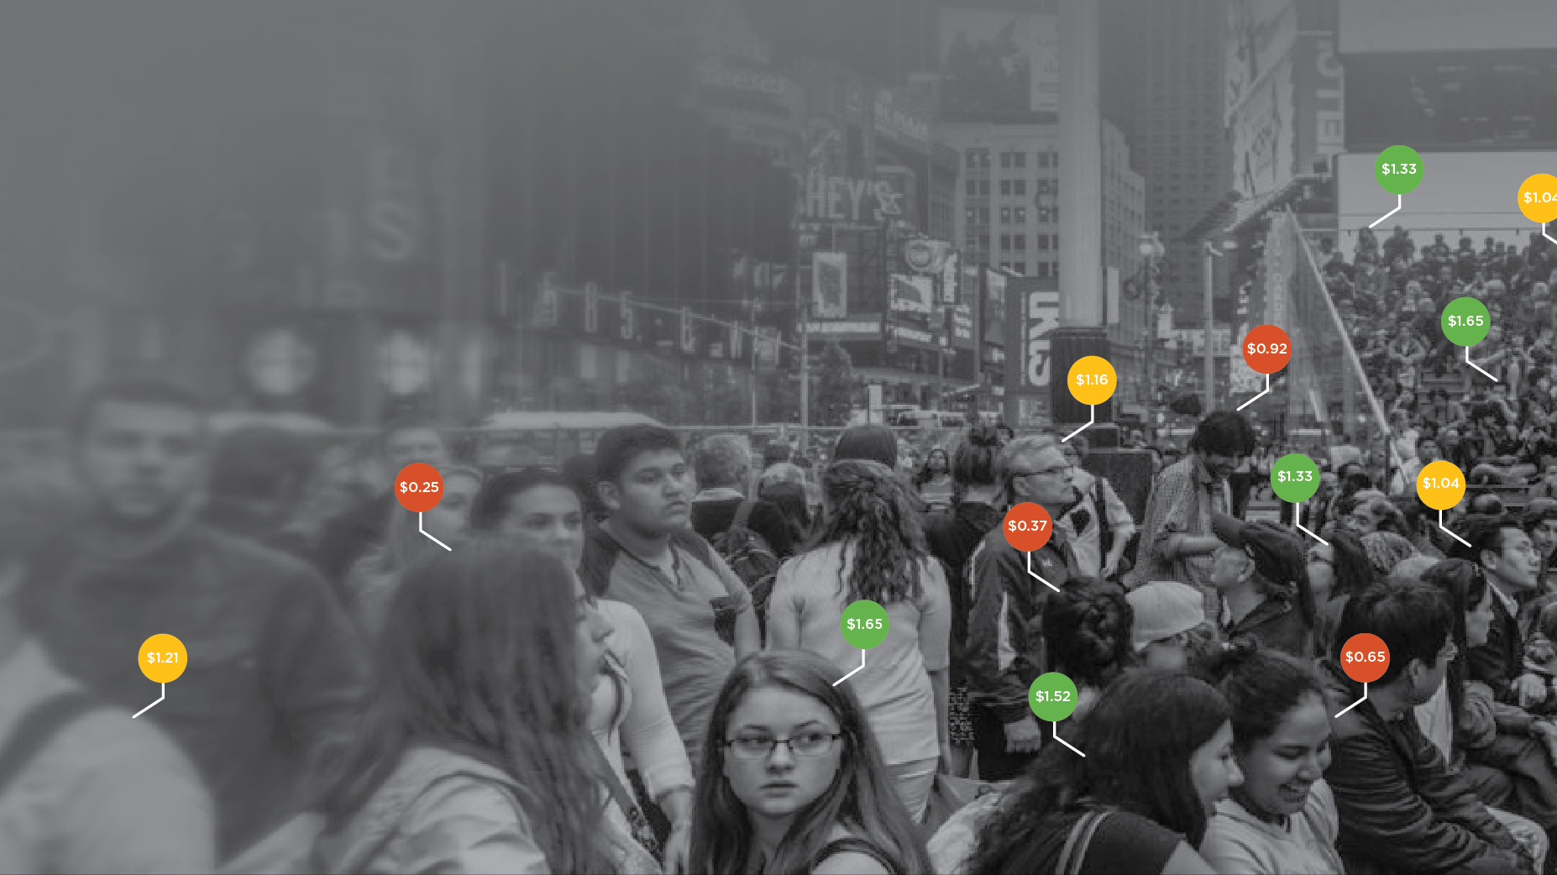
Predicting turn-over
3 classification techniques:
K-Nearest-Neighbors’ Euclidian Distance
Naïve Bayes’ Posterior Probabilities
Logistic Regression using an additive model and LASSO feature selection

Slide 4

Predicting turn-over
Logistic Model
Accuracy 87.7 %
Sensitivity 76.5%
Specificity 88.5 %
Misclassification Rate 12.3%

Slide 5
Top 3 predictors of attrition
Estimates represent the median per unit increase when all other variables are held constant
Category levels coded as integers to provide single summative coefficient

Slide 6

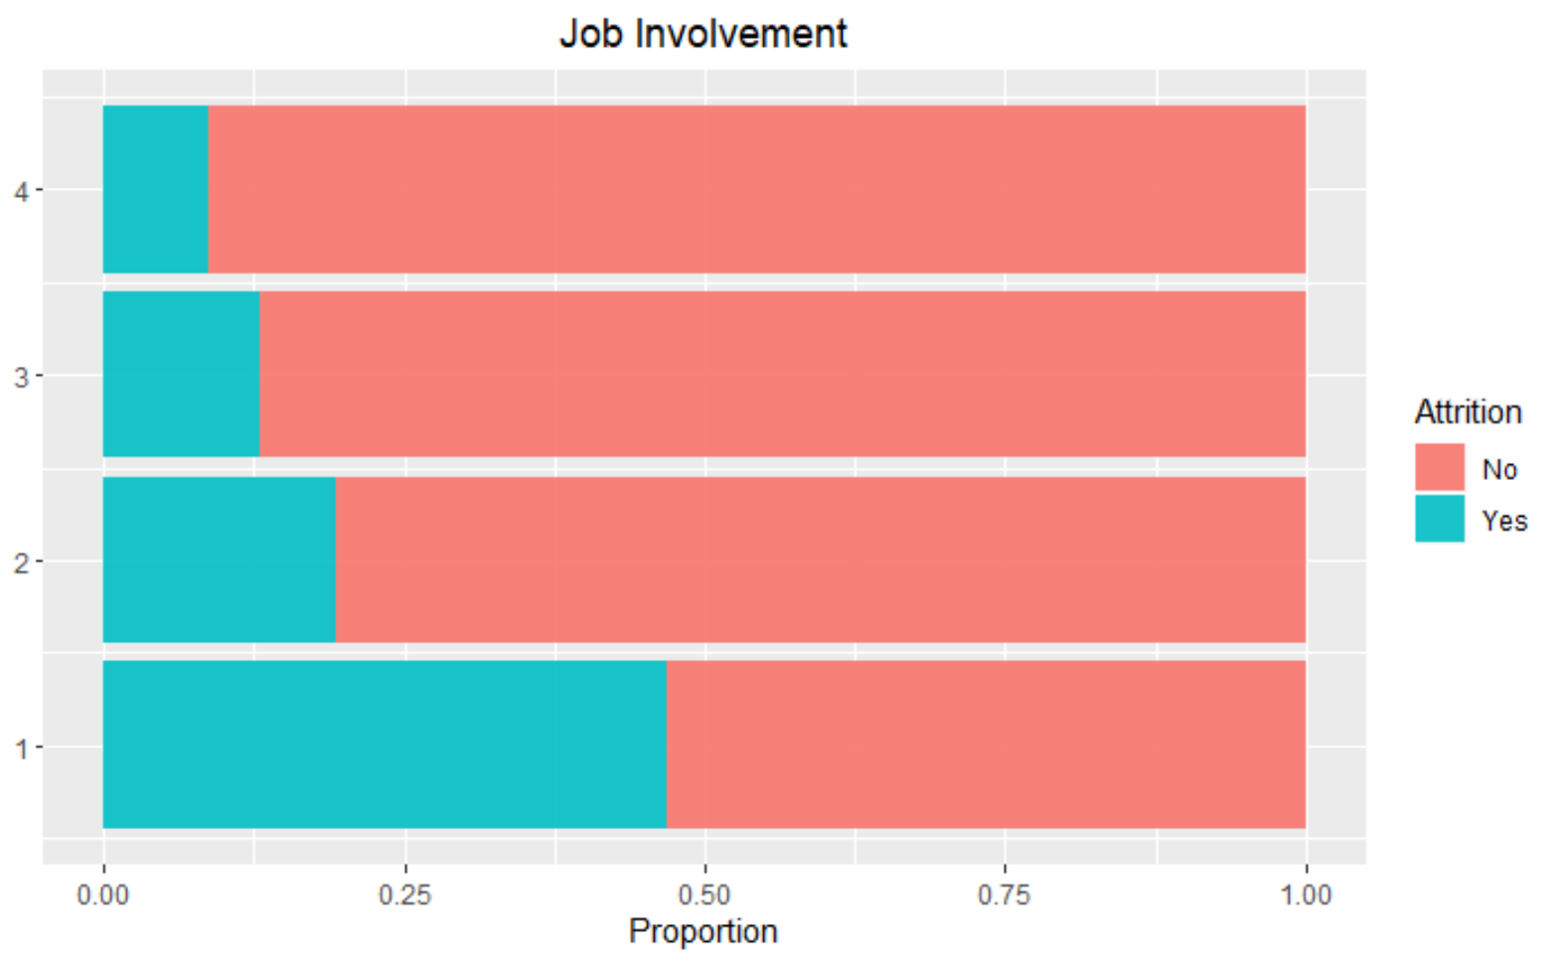
# 3 Level of job involvement
Employees who reported being less involved in their job tend to leave.
For each unit increase in reported job involvement, the median odds of the employee quitting decrease by an estimated 53.27%

Slide 7
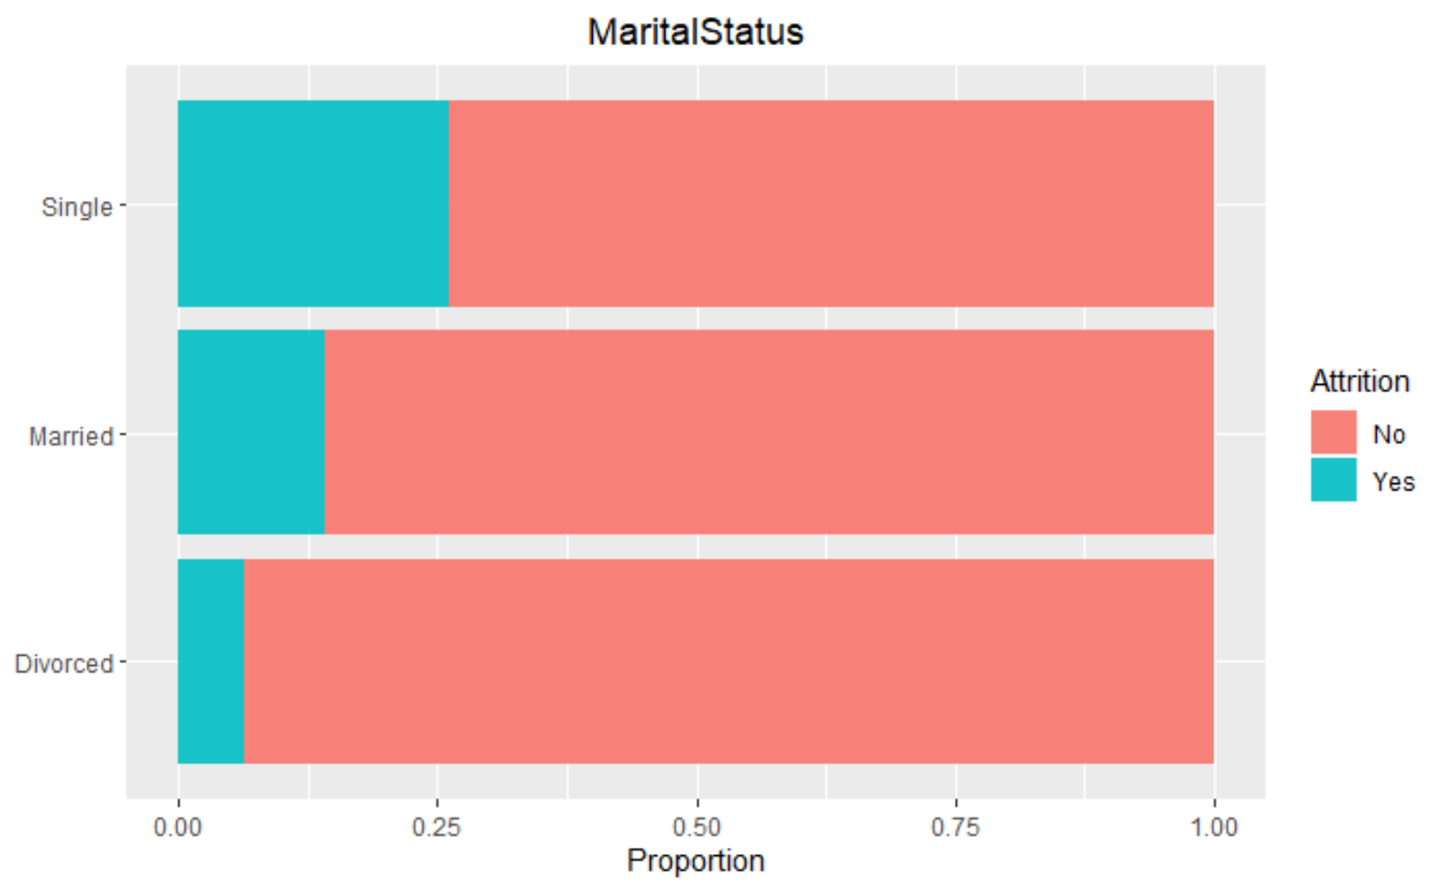
# 2 Marital Status
Single employees are the most likely group to leave their job.
With each step increase, the median odds of the employee quitting increase by an estimated 2.27 times the previous level.

Slide 8
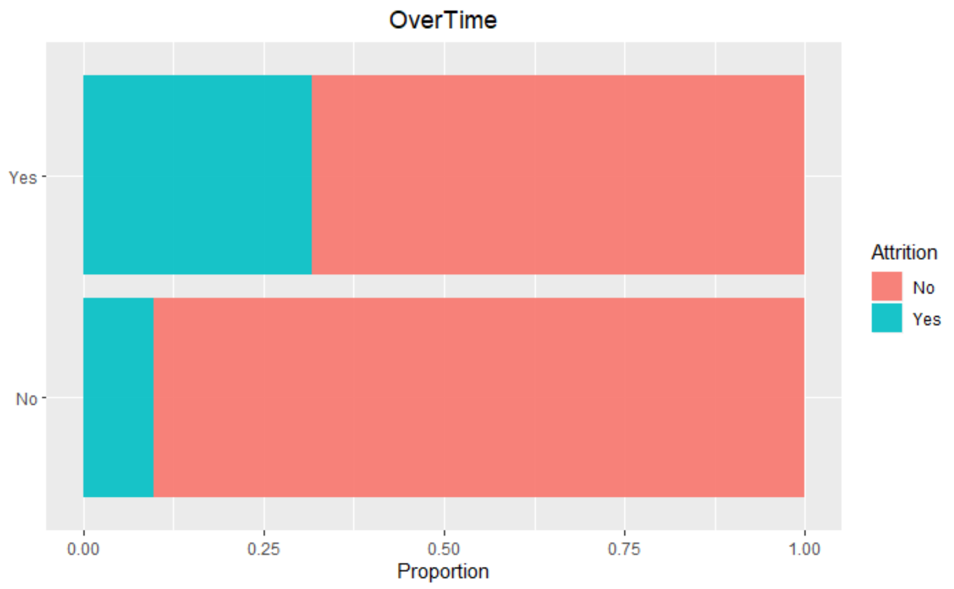
#1 Working Overtime
Working overtime has the greatest impact on and employee’s decision to leave the company.
The median odds of an employee who responded “Yes” to working overtime quitting are about 4 times greater than those who did not respond “Yes” to working over-time.

Slide 9
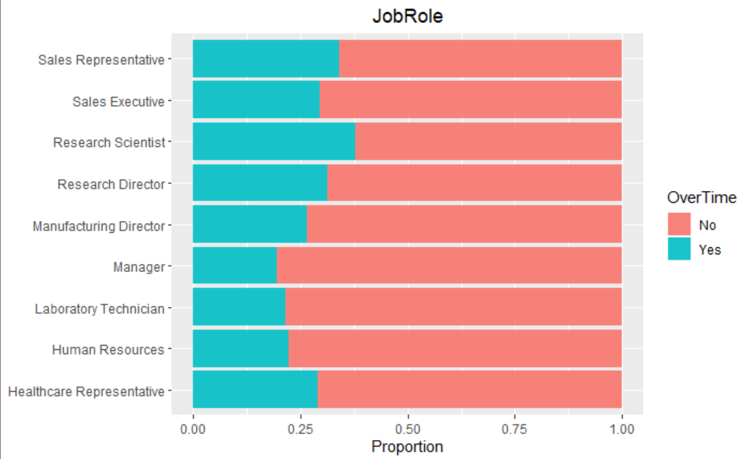
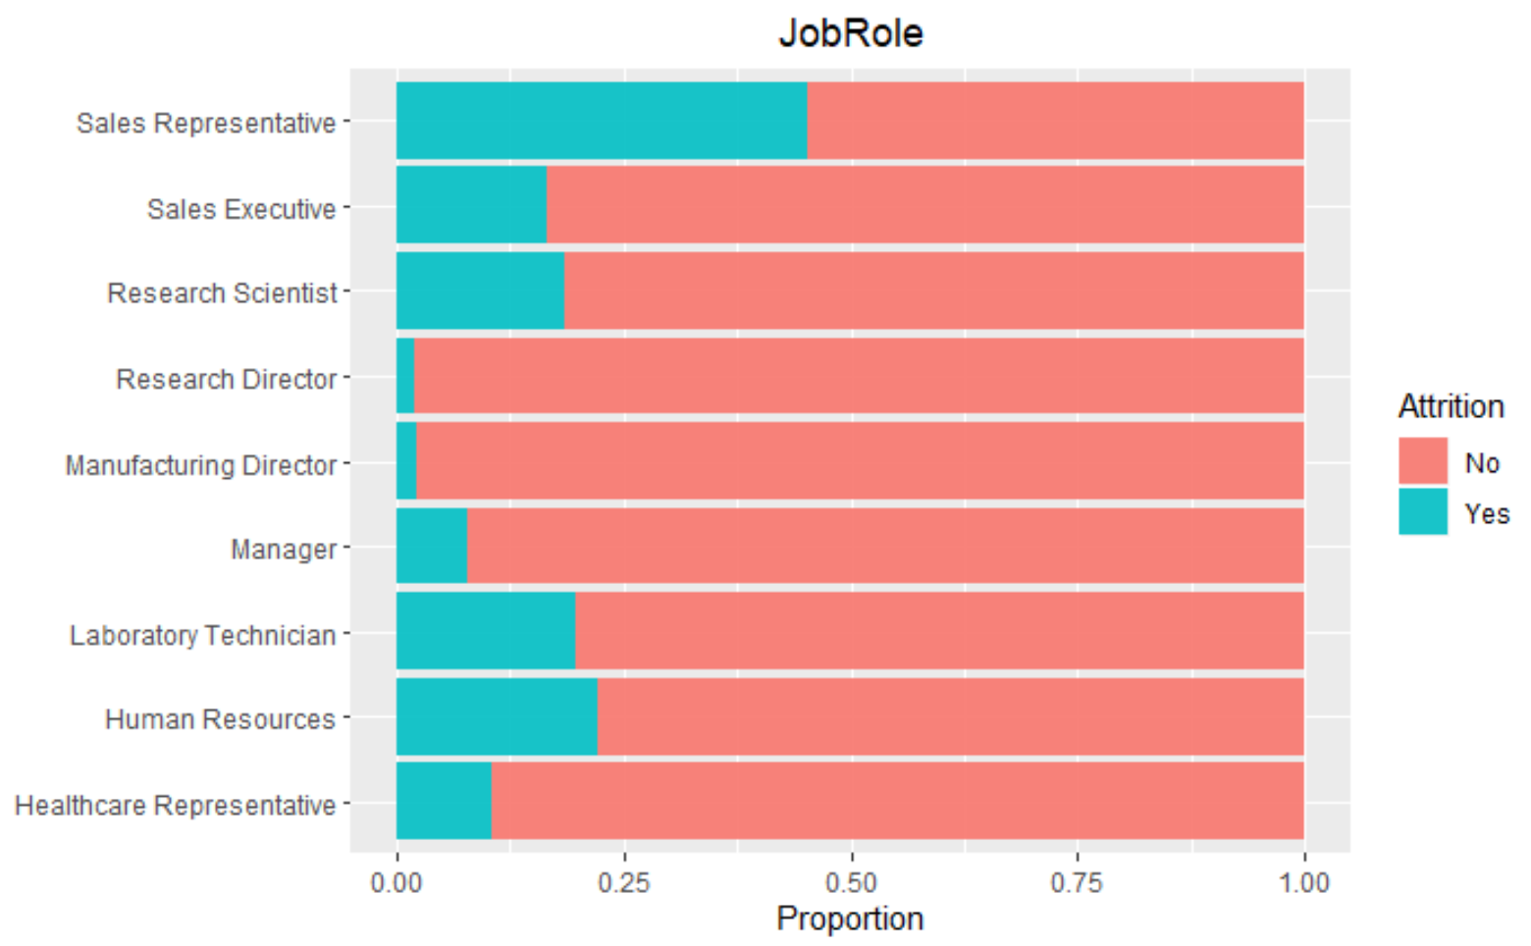
who works over-time?
Research Scientists
Sales Representatives
Research Directors
Which positions experience turn-over?
Sales Representatives
Human Resources
Laboratory Technicians
Research Scientists

Slide 10
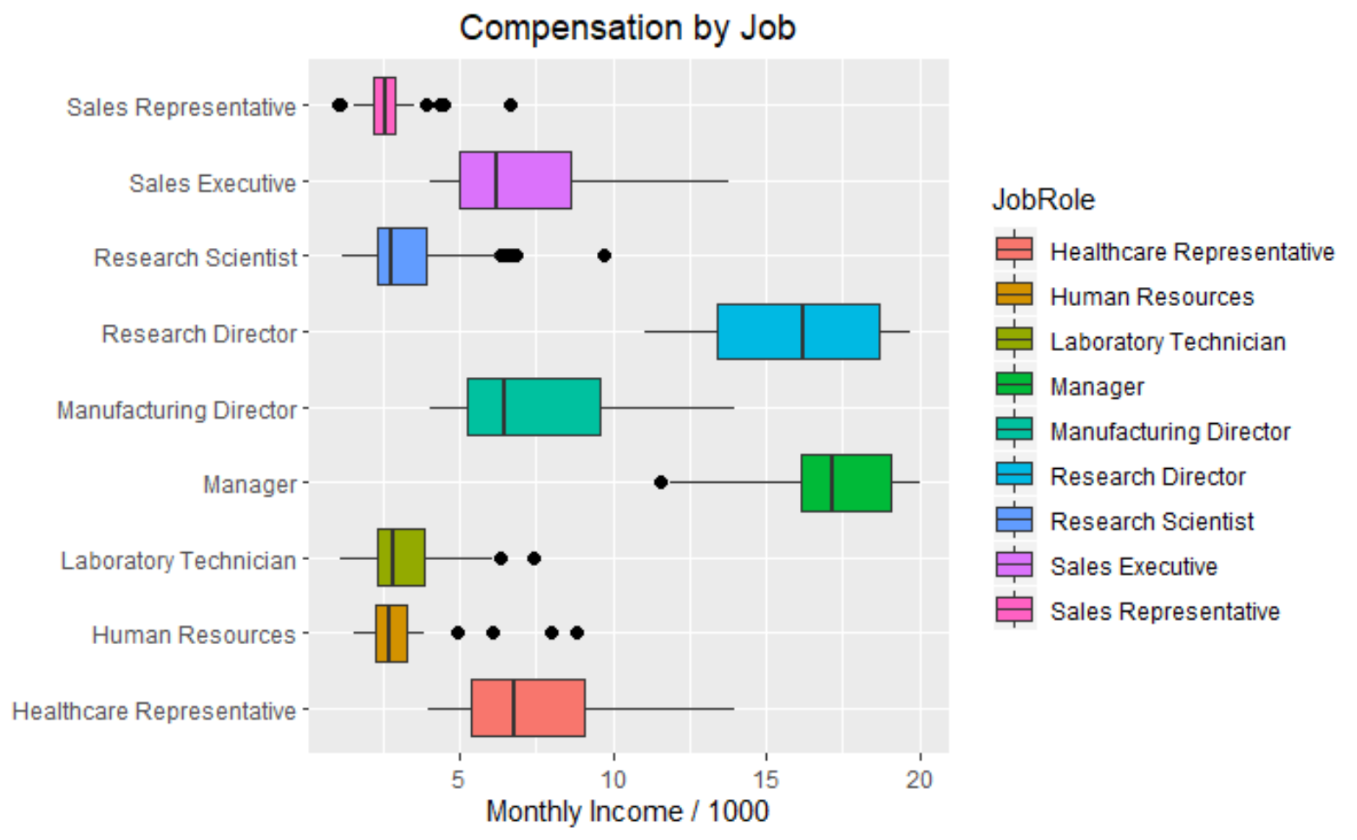
Monthly Compensation
Min. | Q1 | Median | Mean | Q3 | Max
$1081 | $2840 | $4946 | $6390 | $8182 | $19999
What factors determine compensation at DDS Analytics?
Job Role
Job Level
Holding all variables constant:
Job Level: for each level increase, monthly salary increases by an estimated average of $3691.88

Slide 11
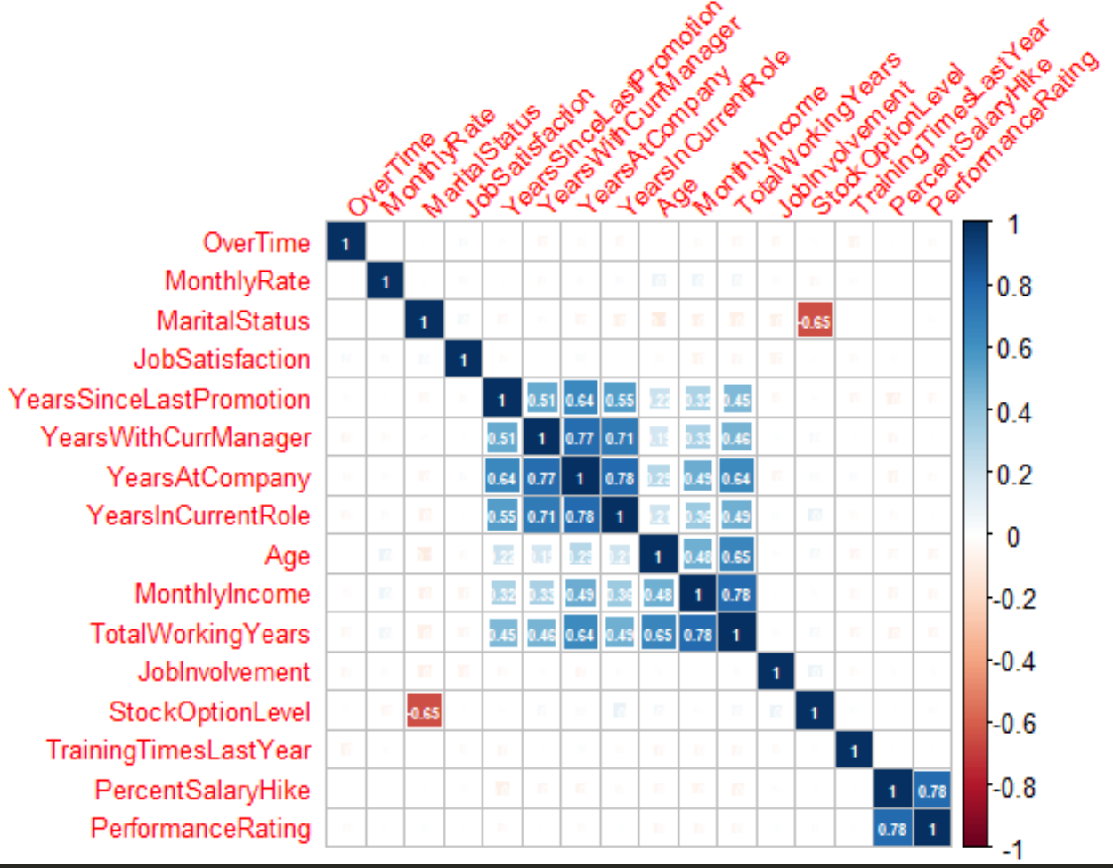
other Connections
Salary is closely correlated with:
Age
Years of experience
Years with the company

Slide 12
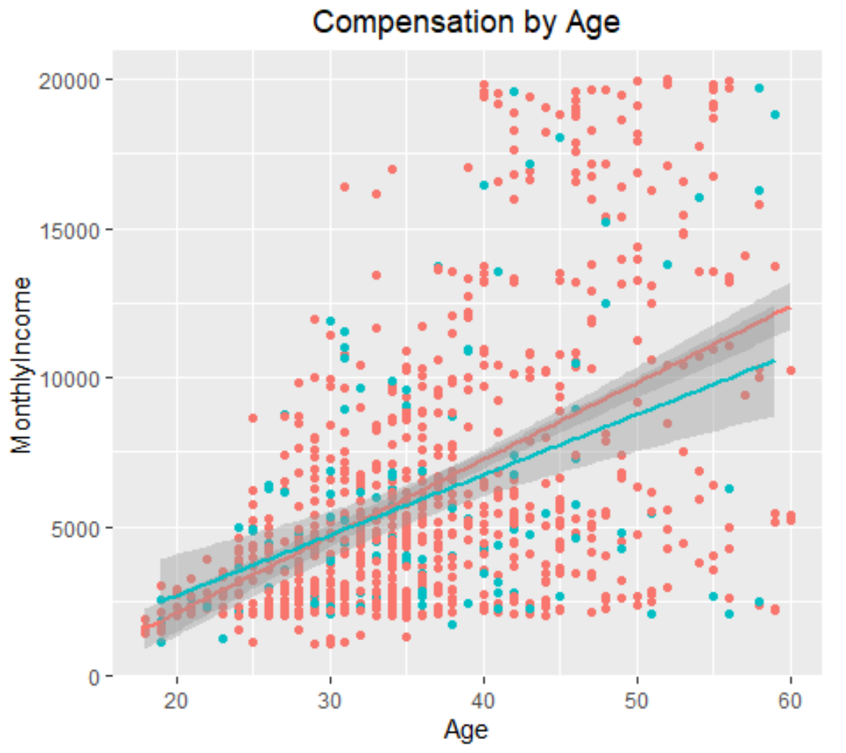
Correlations
Age plays a significant role
Pearson’s R correlation of 48%
What do the colored dots represent?
Performance level!
Pearson’s R correlation of
-4.3%
Why? Age.

Slide 13
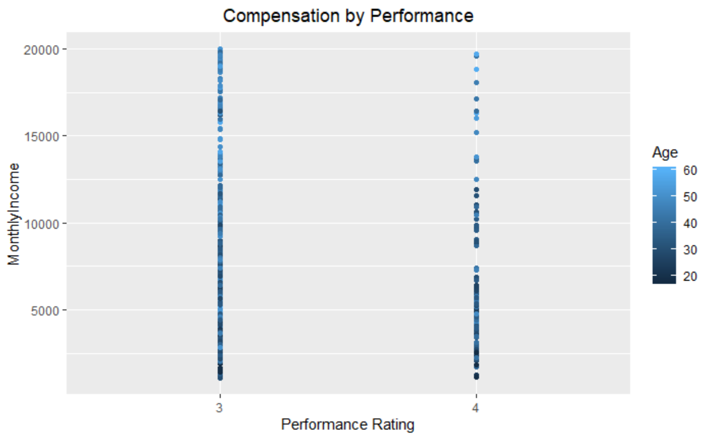
Performance by Age
Age is more closely correlated with salary than performance.
Older employees have lower performance ratings, but higher salaries.

Slide 14
Thank you
For more details, please refer to the included report.

Slide 15
Additional detail
Each variable has levels, for additional detail on, we can look at the most influential categories.
Marital status is negatively correlated with Stock Option Levels
Single employees have lower stock option levels
Single employees are also the most likely to leave the company

Slide 16
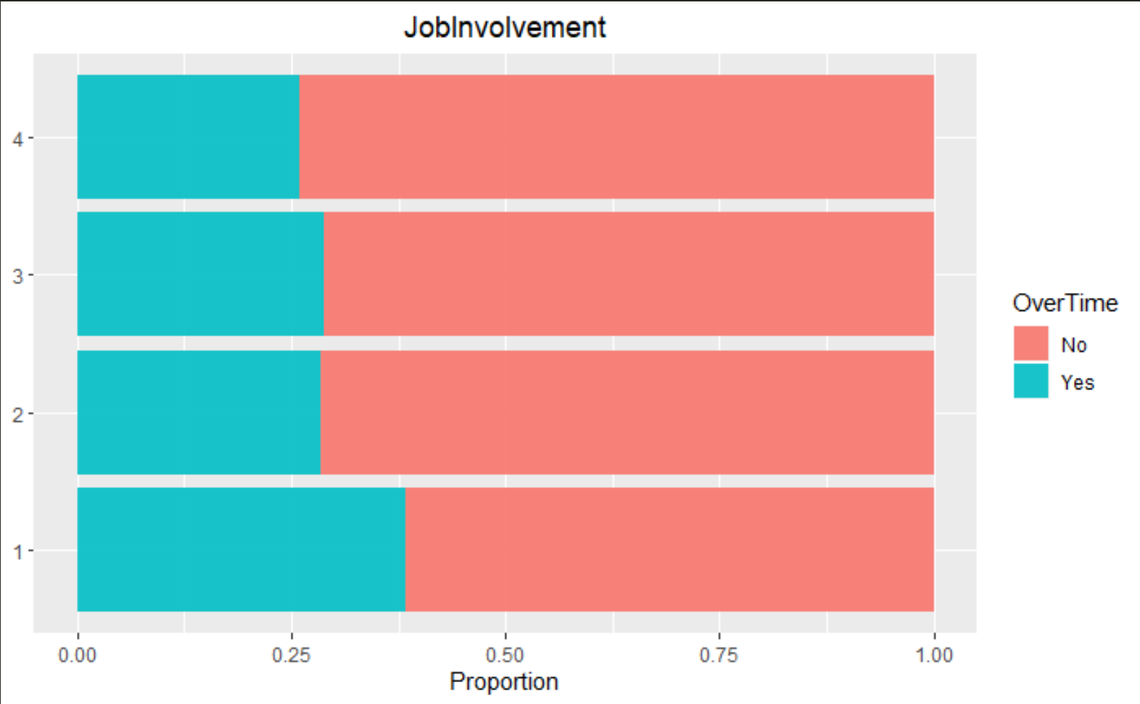
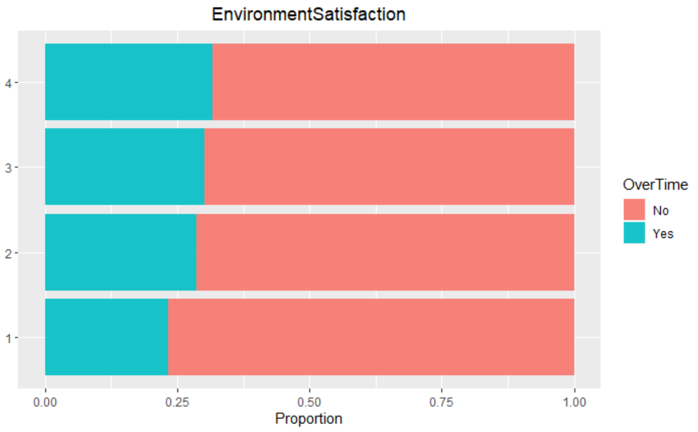
Over-time vs. Satisfaction
Employees who reported working over-time also expressed that they were:
Less involved with their job
The #3 predictor for attrition
More satisfied with their work environment

Slide 17
Top Ten factors
Factor | Model Coefficient | Interpretation
Working Overtime | 1.367 | The estimated odds of attrition for an employee who works over-time are 3.92 times greater than for those who do not work over-time.
Marital Status | .824 | With each level increase in Marital Status, the estimated odds of attrition increase by 2.27 times the previous level.
Level of Job Involvement | -.629 | With each level increase in Job Involvement, the odds of attrition decrease by 53.31%
Work-Life Balance | .308 | With each level increase in Work-Life Balance, the odds of attrition decrease by 73.49%.
Job Satisfaction | .248 | With each level increase in Job Satisfaction, the odds of attrition decrease by 72.12%.
Years Since Last Promotion | .183 | For each year after an employee’s last promotion, the estimated odds of attrition rise by 34%.
Environment Satisfaction | .168 | With each level increase in Environment Satisfaction, the odds of attrition are 78.11% less.
Job Level | .129 | With each level increase in Job Level, the estimated odds of attrition rise by 28.9% .
Number of Companies Worked For | .114 | For every company an employee has worked for previously, the estimated odds of attrition rise by 12.07%
Relationship Satisfaction | .111 | For every company an employee has worked for previously, the estimated odds of attrition rise by 11.73%

